Slide 1
Math Word Problem Solver
Andrew Wu, Akshat Iyer, Sebastian Perez, Eugene Kim, and Will Noonan

Slide 2
Setup: Problem Definition
The goal is to optimize Natural Language Processing models to perform well on standardized test practice (SAT, ACT, etc.)
Model to get answer first
Expand to reasoning later
Many students struggle with standardized test preparation. We seek to build a first step towards a reasoning model that can help
Focused on outputting the correct answer
Success measured by scoring on question banks
Normalized Levenshtein Distance
Raw Accuracy

Slide 3
Literature: What approaches are being used
Variable Scope: elementary to cutting-edge research
CoT or Not?
Chain-of-thought: uses step-by-step reasoning
Direct: models give a single output with no intermediate steps
Zero or Multi-Shot CoT
Zero-shot: no training on reasoning steps
Multi-shot: training data includes intermediate reasoning steps
Tool-Augmented Approaches
LLMs use external tools to handle calculations or other operations
Thinking or NoThinking Approaches (preprint)
Use prompting to bypass the thinking process
Low-budget, high performance (especially with best-of-N generation)

Slide 4
Setup: Data (Basic)
We used an SAT-like dataset from Kaggle
Includes problem, options, correct, annotated formula, and more
Problem: “A big container is 40% full with water. If 14 liters of water is added, the container becomes 3/4 full. What is the capacity of the big container in liters?”
Options: a) 32 , b) 36 , c) 40 , d) 44 , e) 48
Correct: c
Annotated formula: divide(14, subtract(divide(3, 4), divide(40, const_100)))

Slide 5
Setup: Data (Processing)
Some errors with the basic math
Attempted to filter out by using a Regex-based parser on the annotated formula
Removal of ‘const’ in favor of just numbers
This token was used to delineate real-life constants (such as 100 percentage points)
Omission or addition of ‘const’ generally doesn’t change meaning
Malformed questions and answers
Removed questions beyond 100 tokens and answers beyond 30 tokens
95% of questions are < 90 tokens
Lower answer tokens allows higher precision on our small dataset
Spacing
For every operator (add, subtract, etc), append ‘(’
Operator always comes with ‘(’ - treat it as one
Opposite token ‘)’ remains separate
Commas are their own token - don’t want them associated with numbers

Slide 6
Setup: Data (Processing)
Original: multiply(multiply(divide(360, 6), 4), const_100)
Spaced Out: multiply ( multiply ( divide ( 360 , 6 ) , 4 ) , const_100 )
Const Removal: multiply ( multiply ( divide ( 360 , 6 ) , 4 ) , 100 )
Operator Fusing: multiply( multiply( divide( 360 , 6 ) , 4 ) , 100 )

Slide 7
Setup: Data (Methods)
Original Idea: predict answer directly based on question
Given ‘A big container is 40% full with water. if 14 liters of water is added, the container becomes 3/4 full . what is the capacity of the big container in liters?’, predict ‘40’ directly.
Pro: avoids secondary conversion
Con: harder to assign representative loss
Second Idea: predict the annotated formula
Given the same problem, predict ‘divide(14, subtract(divide(3, 4), divide(40, const_100)))’
Pro: gives more information about model performance
Con: extra step needed to process the expression

Slide 8

Setup: Our Evaluation Metrics
Normalized Levenshtein Distance
Compare edit distance between predicted formula and ground truth
Formulas above a 0.9 Levenshtein score tend to be correct, or functionally equivalent
Limited exceptions
Mathematical Accuracy
Percentage of test set where the answer is correct
Loss Monitoring: Tracked average loss over iterations
Unsloth: GRPO Loss
Transformer: Cross-Entropy Loss
D = Edit Distance

Slide 9

Unsloth: R1 Model
Unsloth/tinyllama-bnb-4bit
Relatively lightweight
Low Rank Adaption (LoRA) fine tuning
Low-rank adapter matrices in frozen attention layers (reduced memory usage)
GRPO Loss with an external Reward Function
RL-based method to train models from ranked completions
Reward(actual, predicted) = 1 if error < 0.003 else 0
The difference accounts for floating point imprecision on calculation.
GRPO Loss:

Slide 10
Unsloth: Training Process and Implementation
Experimentation without using formulas
Testing Unsloth’s ability to perform mathematical operations
Custom prompt format:
math_prompt = """### Question: {} ### Choices: {} ### Answer: {}"""
Reward computed by evaluating answers generated (1 if correct, 0 if not)
3 epochs, logging every 10 steps

Slide 11
Unsloth: Preliminary Results
Model frequently restated the prompt without providing an answer
Sometimes provided an answer but most of the time the answer was just wrong
High average loss (>1.0 across 3k steps), indicating optimization difficulty
Change in approach → Predict Answer Formula

Slide 12
Setup: SymPy Overview
Python Library for symbolic math solving
Step 1: Simplification using Regex
Inputs: functional (annotated) formula
Outputs: symbolic representation of formula
Step 2: Solving
Inputs: symbolic representation
Outputs: answer to the formula
Original: multiply( multiply( divide( 360 , 6 ) , 4 ) , 100 )
Simplified: (((360 / 6) * 4 ) * 100)
Answer: 24000
Regex
SymPy

Slide 13
Literature: Change in Scope
“What is the answer” → “What is this question really asking”
SymPy ‘conceptually’ changed this from a reasoning problem to a semantic parsing problem
We didn’t know this at the time, but the properties of these problems are very different

Slide 14
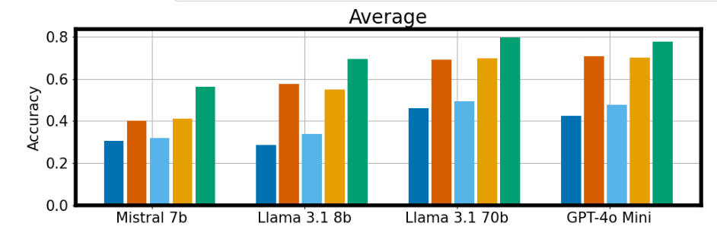
Literature: Symbolic Solvers
20% better with symbolic solver approach in He-Yueya et al. 2023
Sprague et al. 2024:

Slide 15
Unsloth: Training Process and Implementation
Data Loading: SAT-style math problems from CSV
Custom prompt format:
### Math Word Problem: {} ### Extract the formula used to solve it: {}
Tokenized up to 2048 tokens with truncation
Training takes too long with more than 2048 tokens
Most of our data does not exceed this number of tokens
3 epochs, logging every 10 steps

Slide 16
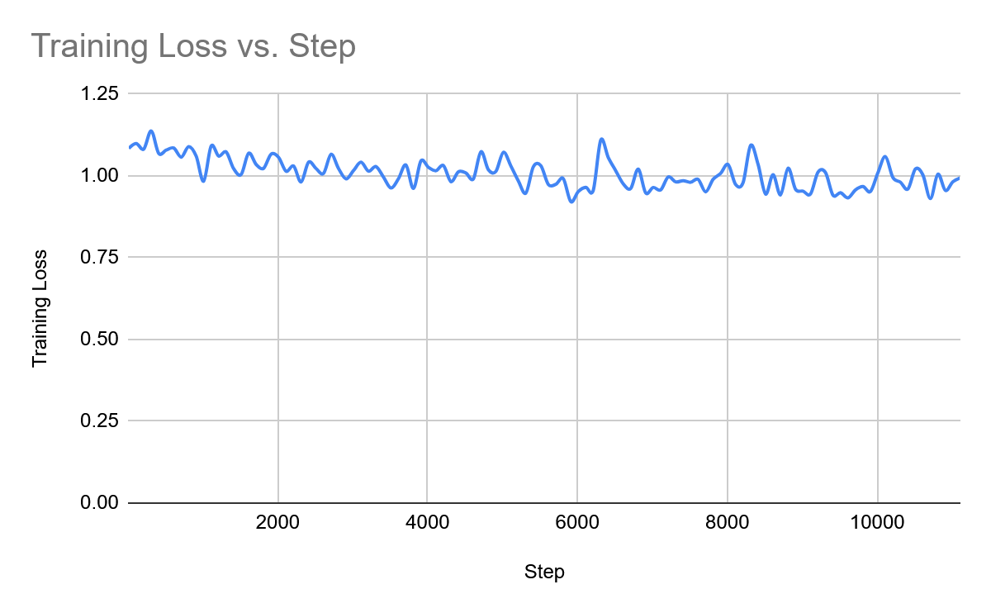
Unsloth: Results
Reasonable success on single-step problems
Model frequently hallucinated or repeated formula elements
divide(36, add(multiply(multiply…
Metrics:
High average loss (~1.0 across 10k steps)
Indicates optimization difficulty
Levenshtein score of ~0.5
49% accuracy on test set

Slide 17
Unsloth: Reflection
Strengths
Limitations
Quick to prototype
Many different models to try
Baselines provided by the Unsloth Team
Even the smallest models are huge - with limited data it is fairly difficult to not underfit or overfit.
Repetition/hallucination (most likely underfitting)
Inability to reliably generalize across problem types
Very long training time, heavily resource intensive
Multiple hours to see anything at all (roughly 1 step/s, 10k+ steps usually needed)
These challenges motivated further experimentation with other models

Slide 18
Transformer: Overview and Motivations for Switching
Strong benchmarks in NLP and text-to-text tasks
Significantly outperform non-transformer NLP models like LSTM or RNN
More lightweight when compared to Llama 3, with better efficiency on shorter tasks
Transformers scale computations with the square of sequence length, but our data is fairly short and light
Trains to convergence much faster, at least for our task
Better integration with downstream symbolic tools like SymPy
More optimized to specific NLP tasks, whereas Llama is more broad and conversational

Slide 19
Literature: To CoT or not to CoT” (Sprague et al. 2024)
Math problems have two steps
1 - Planning: parsing a problem into equations
2 - Execution: intermediate outputs build to a solution
“Finding 2: CoT primarily helps with the execution steps that performs computation and symbolic manipulation, but falls short of what LLMs with tool augmentation can do.”
Why move away from CoT?

Slide 20
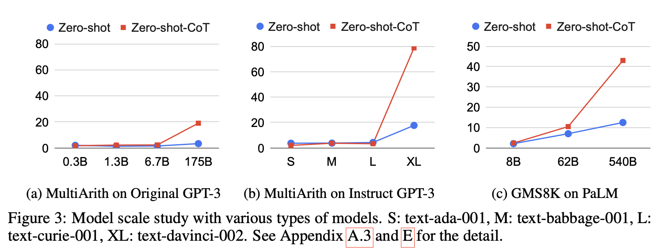
Literature: Model Size
CoT accuracy increases in larger models (Kojima and Gu, 2022)
Previous Model: Llama3 ~8B

Slide 21

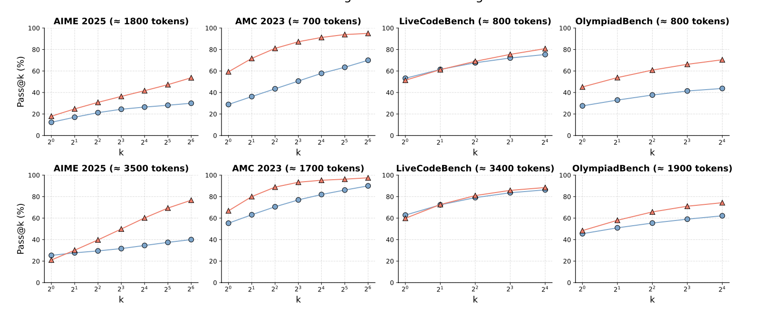
Literature: CoT/Not, Token Limits, Problem Difficulty
Easier
Harder
Hardest
Fewer Tokens
More
Tokens
Ma et al. 2025 (preprint)

Slide 22
Transformer: T5 Architecture
Reframes all NLP tasks as ‘text-to-text’
Classification: output one token
Generation: output multiple
Pre-trained on the Common Crawl Dataset
Web-scraped data
Cross-Entropy Loss: CE Loss = -∑y_{i}​log​(p_{i}​)
Autoregressive
Predicts the next word (token) given the previous context
FLAN-T5-Base
Evolution of T5, tuned to understand the reasoning behind topics better
Our choice for this model due to this extra layer of pre-training
250M parameters (compare to Llama 3’s 8B)

Slide 23
Transformer: Proof of Concept Outline
Truncate all formulas to just their first token
Always an operator for our data
Does not always “match” the logical option
Q: “What quantity of water should be added to reduce 9 liters of 50% acidic liquid to 30% acidic liquid?”
A: subtract(divide(multiply(multiply(... -> truncates to ‘subtract(’
Turns the task into a classification problem, rather than a generation problem
Testing to see if FLAN-T5 Architecture can be effective on our data

Slide 24
Transformer: Proof of Concept Process
Dataset Creation
Google FLAN-T5 Base Tokenizer
Problem tokenized, maximum 1024 tokens (higher than the maximum in the dataset)
Answer tokenized, maximum 1 token (truncation)
Source Mask (make sure padding doesn’t affect loss)
Training
AdamW Optimizer
Learning Rates: 3e-5, 5e-5, 8e-5
Precision: 16, 32

Slide 25
Transformer: Proof of Concept Results
Quantitative
Qualitative
Raw Accuracy: 0.96
(Baseline ~0.25)
Normalized Levenshtein Dist.: 0.96
(Baseline ~0.25)
Loss converges to ~0.2 relatively quickly
Able to process meaning beyond buzzwords
“What quantity of water should be added to reduce 9 liters of 50% acidic liquid to 30% acidic liquid?” -> ‘subtract(’
Learning rate has little effect, as it converged fairly quickly each time
No discernable difference in result after 8 epochs
16 precision does not work -> results in NaN loss
32 fixes, but is slower to train
High memory usage, outrunning even A100 (40GB) on batch size 16
Lack of input truncation

Slide 26
Transformer: Full Token Process
Dataset Creation
Google FLAN-T5 Base Tokenizer
Problem tokenized, maximum 100 tokens
Answer tokenized, maximum 30 tokens
Cutting down the padding allows for significantly less memory usage
Most answers are not truncated
Source and Target Masks (make sure padding doesn’t affect loss)
Generation problem, no longer classification
Training
AdamW Optimizer
Learning Rates: 3e-5, 5e-5, 8e-5, 1e-4
Weight Decay: 0, 0.001
Dropout: 0, 0.1
Precision: 32
Gradient Clipping: 1.0

Slide 27
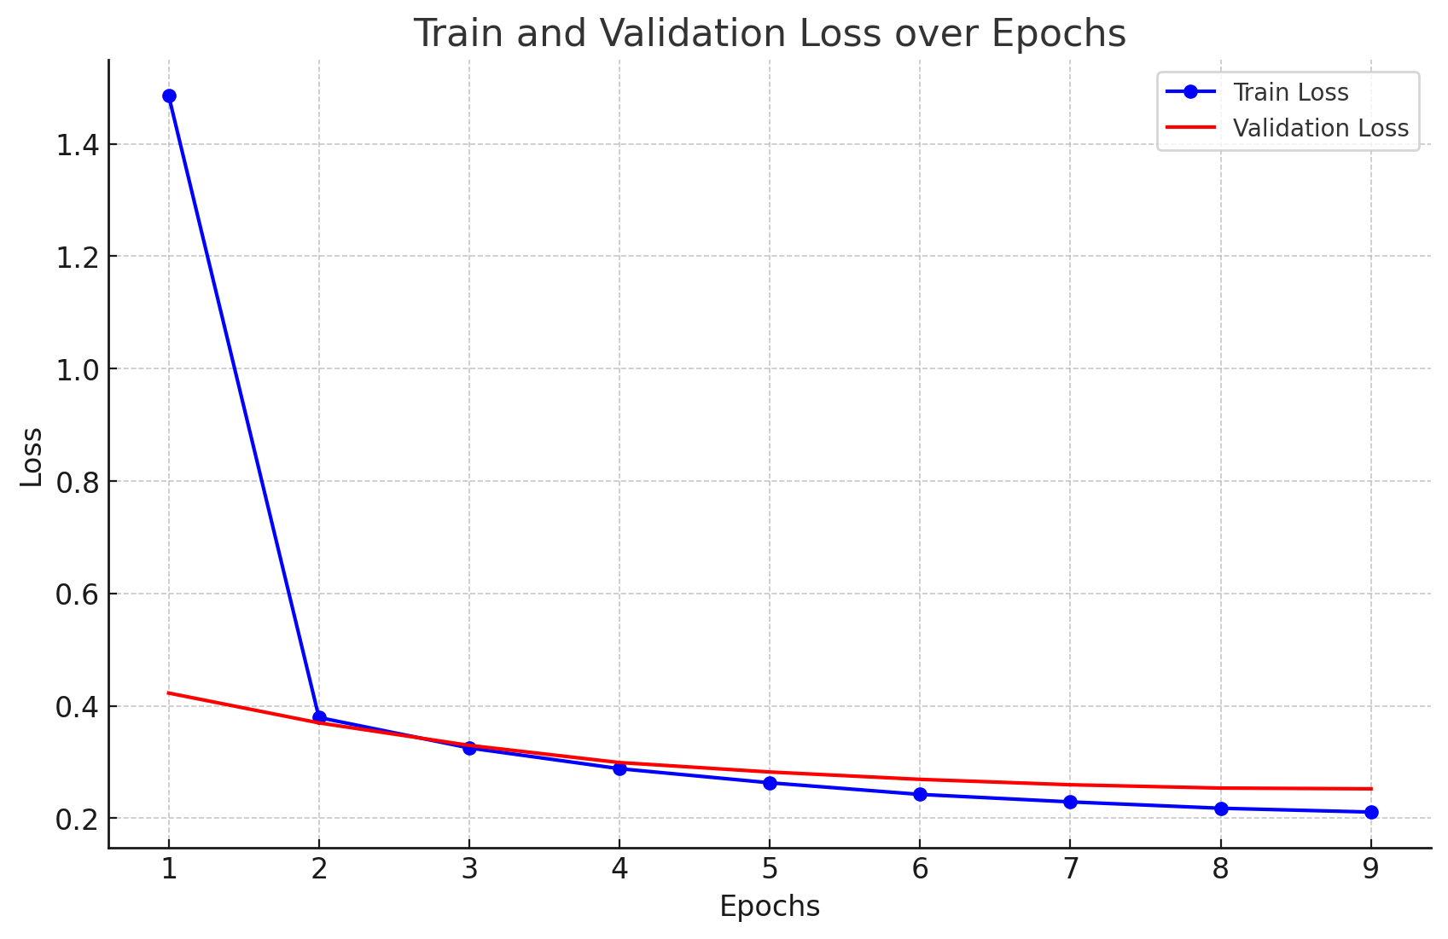
Transformer: Full Token Results
Quantitative
Qualitative
Raw Accuracy: ~0.67 (Baseline: ~0.00)
Normalized Levenshtein Distance: ~0.78 (Baseline: ~0.19)
Loss converges to ~0.25, but slower than in proof-of-concept
Low learning rate has more trouble
Loss does not converge in reasonable time for low learning rates, with the full token representation (with the lowest rates tried, would’ve been hundreds)
Regularization (weight decay, dropout) decreases performance
Ruins self-attention
AdamW optimizer already has regularization
Safely ran batch size 32 or even 64 due to n² scaling
Less tokens in input (and increase in batch size) increases training speed
~15 mins per epoch -> 2-3 minutes per epoch

Slide 28
Transformer: Full Token Results
 | Correct | Functionally Equivalent
Question | Solution x is 10 percent alcohol by volume, and solution y is 30 percent alcohol by volume. How many milliliters of solution y must be added to 150 milliliters of solution x to create a solution that is 25 percent alcohol by volume? | An agent gets a commission of 2.5% on the sales of cloth. If on a certain day, he gets 12.50 as commission, the cloth sold through him on that day is worth…
Prediction | multiply( divide( subtract( 25 , 10 ) , subtract( 30 , 25 ) ) , 150 ) | divide( 12.50 , divide( 2.5 , 100 ) )
Actual | multiply( divide( subtract( 25 , 10 ) , subtract( 30 , 25 ) ) , 150 ) | divide( 12.5 , divide( 2.5 , 100 ) )

Slide 29
Transformer: Full Token Results
 | High Score but Inaccurate | Incorrect
Question | A can finish a work in 24 days and B can do the same work in 15 days. B worked for 10 days and left the job. In how many days can A alone finish the remaining work? | Sheila works 8 hours per day on Monday, Wednesday, and Friday, and 6 hours per day on Tuesday and Thursday. She does not work on Saturday and Sunday. She earns $324 per week. How much does she earn in dollars per hour?
Prediction | divide( multiply( multiply( divide( 1 , 15 ) , 10 ) , 24 ) , 5 ) | multiply( divide( 324 , add( 8 , 6 ) ) , 8 )
Actual | divide( multiply( multiply( divide( 1 , 15 ) , 10 ) , 24 ) , 2 ) | divide( 324 , add( multiply( 8 , 3 ) , multiply( 6 , 2 ) ) )

Slide 30
Transformer: Reflection
Strengths
Limitations
Better performance with this small dataset than the larger Llama models
Can understand more complex (multistep) problems
Much more lightweight training, time and compute -> more experimentation
One training/validation + testing pass for a hyperparameter combination is no more than 30 minutes to an hour (roughly $1 in compute)
We are not sure why the larger FLAN-T5 models do not generalize as well
Experimented with FLAN-T5-Large (780M), independent of epoch count it did not generalize as well
One training/validation + testing pass is 2-5 hours, making it difficult to experiment with
Cross-Entropy Loss is token-by-token
Formulations need to be dead accurate; one slipped token (for example, a 5 in place of a 2) is not a huge deal to the loss, but completely invalidates the answer

Slide 31
Reflection: All Approaches
What was the number one technical or conceptual difficulty?
Learning the model architectures was the most challenging part of this project, as we were working with models that were new to everyone.
What part of the project workflow was easier than expected? Harder?
Easier: Regex parsing ended up not being bad at all, as it ended up being of similar style to some Leetcode questions (also ChatGPT helped)
Harder: Developing the training loop for the T5 Transformer.
How did your project goals or approach evolve based on self-critiques or intermediate results?
Our approach entirely shifted after we decided to pivot to predicting formulas instead of answers. Instead of it being a reasoning model, we transitioned to it being a Transformation problem.
How did AI tools assist your project (e.g., coding, debugging, writing, brainstorming)? Give specific examples.
ChatGPT was very helpful in creating the boilerplate code for our Regex parser and training loops. We were also able to prompt it to ask how we can improve our model based on our results. For example, before our initial model, we asked GPT how to implement a custom loss/reward function and it provided us with the basic implementation.

Slide 32
Individual Contributions: Andrew
Most surprising result or finding
Most useful topic from class
How my perspective on optimization has changed
If I had two more weeks, what next steps would I take?
Biggest change I would make in hindsight

Slide 33
Individual Contributions: Sebastian
Most surprising result or finding
Most useful topic from class
How my perspective on optimization has changed
If I had two more weeks, what next steps would I take?
Biggest change I would make in hindsight

Slide 34
Individual Contributions: Will
Most surprising result or finding
Most useful topic from class
How my perspective on optimization has changed
If I had two more weeks, what next steps would I take?
Biggest change I would make in hindsight

Slide 35
Individual Contributions: Eugene
Most surprising result or finding
Most useful topic from class
How my perspective on optimization has changed
If I had two more weeks, what next steps would I take?
Biggest change I would make in hindsight

Slide 36
Individual Contributions: Akshat
Most surprising result or finding
Most useful topic from class
How my perspective on optimization has changed
If I had two more weeks, what next steps would I take?
Biggest change I would make in hindsight

Slide 37
Thank You

